Slide 1
Capstone Project The Battle of Neighborhoods
By Eliana Salvemini

Slide 2
Problem explanation
The problem I would like to analyze arises from a personal need: where should I choose to live? In the next month I have to move for job in another city and I will deal with the problem of where taking home.
This is the typical problem that a person who has to be relocated for job has to face.
A person could say to choose a place not too far from the office, but this is not enough. I want to find an area where I can practice my hobbies.
First of all since I am a swimmer I want an area full of swimming pools.
Then since I love to practice sport in general I want to live in an area with gyms and parks where to run and do jogging.
Another person who loves arts and exhibitions could prefer an area full of theaters or cinemas for example. Other people could like going and chilling out in the evening so an area with pubs and clubs would be perfect.
So my problem is in general: find the better place where to live depending on the hobbies and interests of a person.

Slide 3
Data
The data I want to use are the geographical coordinates of Milan city, retrieved from the geolocator API.
In particular I know that the postal codes of Milan city go from 20121 to 20162, so I will get the geographical coordinates of these postal codes.
Next, I will explore with the Foursquare API the different venues for each postal code paying particular attention to the gyms, swimming pools, parks and at the end I will use K-means to cluster the data and choose the cluster that better fits to my hobbies.
I would like to use more data like for example the prices of the houses in the different area but I was not able to retrieve no datasets regarding this. But this could be an idea for future work.

Slide 4
Methodology
First of all I will get the geographical coordinates of the postal codes of Milan City: from 20121 to 20162.
 | Postal Code | Latitude | Longitude
0 | 20121 | 45.472178 | 9.188044
1 | 20122 | 45.461812 | 9.196310
2 | 20123 | 45.462639 | 9.188515
3 | 20124 | 45.484604 | 9.200817
4 | 20125 | 45.499771 | 9.204911
5 | 20126 | 45.513290 | 9.217624
6 | 20127 | 45.496563 | 9.220420
7 | 20128 | 45.515129 | 9.224564
8 | 20129 | 45.470966 | 9.213798
9 | 20130 | 43.244552 | -1.990588

Slide 5
Methodology
I know that my future office is located in 'Via Castellanza 11, 20151 Milan‘ so with geolocator I get its coordinates.
myaddress = 'Via Castellanza 11, 20151 Milan'
geolocator = Nominatim()
location = geolocator.geocode(myaddress)
latitudeMy = location.latitude
longitudeMy = location.longitude
print('The geographical coordinate of {} are {}, {}.'.format(myaddress, latitudeMy, longitudeMy))
The geographical coordinate of Via Castellanza 11, 20151 Milan are 45.5009523, 9.109888.

Slide 6
Methodology
Then for each postal code with Foursquare API I get the top 100 venues with appear in a radius of 1000 meters using as key words: swimming pool, gym and park.
search_query = Swimming Pool or Gym or Park
radius = 1000
LIMIT = 100
CLIENT_ID = # my Foursquare ID
CLIENT_SECRET = # my Foursquare Secret
VERSION = 20180605
and compute the URL:
url = https://api.foursquare.com/v2/venues/explore?client_id={}&client_secret={}&ll={},{}&v={}&query={}&radius={}&limit={}'.format(CLIENT_ID, CLIENT_SECRET, latitude, longitude, VERSION, search_query, radius, LIMIT)

Slide 7
Foursquare API Results for Pool
 | id | name | categories | address | lat | lng
0 | 4c308fa366e40f4734aac38b | Piscina Comunale Lampugnano | [{'id': '4bf58dd8d48988d15e941735', 'name': 'P... | Via Adolfo Omodeo | 45.491386 | 9.115659
1 | 4f0fd180e4b0d3f8a3c90de1 | Virgin Swimming Pool | [{'id': '4bf58dd8d48988d15e941735', 'name': 'P... | Via Alcide de Gasperi 1 | 45.496361 | 9.128447
2 | 51dbaf19498ea602283851a2 | The Hub's pool | [{'id': '4bf58dd8d48988d15e941735', 'name': 'P... | Via Privata Polonia 10 | 45.513616 | 9.119248
3 | 51699a22e4b04259cdd600bf | Superspa by Angelo Caroli @ B4 | [{'id': '4bf58dd8d48988d105941735', 'name': 'G... | NaN | 45.511416 | 9.124666

Slide 8
Foursquare API Results for Gym
 | id | name | categories | address | lat | lng
0 | 4cac3b1744a8224bda8e3140 | Virgin Active | [{'id': '4bf58dd8d48988d175941735', 'name': 'G... | Viale Alcide De Gasperi, 2 | 45.496443 | 9.128483
1 | 4d42a020b6e73704fbda8609 | Way Out | [{'id': '4bf58dd8d48988d176941735', 'name': 'G... | Via Sapri, 64 | 45.503863 | 9.130028
2 | 4defe40fd16486e86e4d90a3 | Capelli e Sforza | [{'id': '4bf58dd8d48988d176941735', 'name': 'G... | Via Lampugnano 80 | 45.490882 | 9.113795
3 | 52ed2d6a498e23a6618ffdae | CrossFit San Siro | [{'id': '4bf58dd8d48988d176941735', 'name': 'G... | Via Gallarate 207 | 45.499128 | 9.124770
4 | 51c3530c498e5911e791b1fd | Rockspot | [{'id': '503289d391d4c4b30a586d6a', 'name': 'C... | NaN | 45.511383 | 9.091387

Slide 9
Foursquare API Results for Park
 | id | name | categories | address | lat | lng
0 | 4bf026f1d4e4d13a97ea15a7 | Parco di Trenno | [{'id': '4bf58dd8d48988d163941735', 'name': 'P... | Via Cascina Bellaria | 45.484267 | 9.107022
1 | 55af50bb498e3c69cda54dfb | Cascina Merlata | [{'id': '4bf58dd8d48988d163941735', 'name': 'P... | Via Gallarate | 45.506671 | 9.103671
2 | 4f07fdcbe4b0e624d6a9eb3e | Parco Sandro Pertini | [{'id': '4bf58dd8d48988d163941735', 'name': 'P... | Via Francesco Cilea | 45.497012 | 9.110018
3 | 4c963c94f7cfa1cd734fc415 | Circolo Ricreativo RCS | [{'id': '4bf58dd8d48988d163941735', 'name': 'P... | NaN | 45.500119 | 9.117218
4 | 4f89ac89e4b09efba1b8554b | Spazio Gorlini | [{'id': '4bf58dd8d48988d163941735', 'name': 'P... | Parco Di Trenno | 45.489359 | 9.102798
5 | 4cbd58244495721ec7215f7a | Giardini dei Caduti di Nassiriya | [{'id': '4bf58dd8d48988d163941735', 'name': 'P... | Via Benedetto Croce | 45.494014 | 9.128630
6 | 4d8a291399c2a1cdde908ad7 | Parco Naturale Pero Atahotel | [{'id': '4bf58dd8d48988d163941735', 'name': 'P... | Via Giovanni Keplero, 21 | 45.503373 | 9.086651
7 | 4e144d4414951daa08a8dccf | Parchetto Trenno | [{'id': '4bf58dd8d48988d163941735', 'name': 'P... | Via Trenno | 45.488790 | 9.126559

Slide 10
Milan_venue dataframe
Each Foursquare API run produces a venue dataframe. I concat the 3 dataframes for swimming pool, gym and park and obtain milan_venues.
 | Postal Code | Postal Code Latitude | Postal Code Longitude | Venue | Venue ID | Venue Latitude | Venue Longitude | Venue Address | Venue Category
0 | 20121 | 45.472178 | 9.188044 | Boscolo Milano, Autograph Collection | 4ba68fd0f964a5208b5e39e3 | 45.466514 | 9.193668 | Corso Matteotti 4/6 | Park
1 | 20121 | 45.472178 | 9.188044 | acqua go | 54fefc01498ea7e049439d53 | 45.477745 | 9.184486 | NaN | Gym Pool
2 | 20122 | 45.461812 | 9.196310 | Boscolo Milano, Autograph Collection | 4ba68fd0f964a5208b5e39e3 | 45.466514 | 9.193668 | Corso Matteotti 4/6 | Park
3 | 20122 | 45.461812 | 9.196310 | Physioclinic | 4c9daae40e9bb1f744c1df5f | 45.461423 | 9.205257 | Via Fontana 18 | Gym
4 | 20123 | 45.462639 | 9.188515 | Boscolo Milano, Autograph Collection | 4ba68fd0f964a5208b5e39e3 | 45.466514 | 9.193668 | Corso Matteotti 4/6 | Park

Slide 11
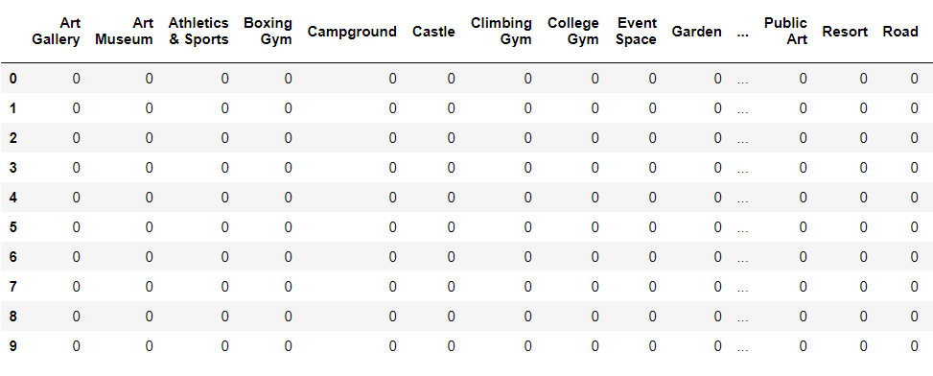
One hot encoding
Then I applied the one hot encoding using the pd.get_dummies() method and produce the milan_onehot dataframe.

Slide 12
One hot encoding
Here are the different venues categories that the one hot encoding produces:
Art Gallery, Art Museum, Athletics & Sports, Boxing Gym, Campground, Castle, Climbing Gym, College Gym, Event Space, Garden, General Entertainment, Gym, Gym / Fitness Center, Gym Pool, Harbor / Marina, Hotel, Italian Restaurant, Lake, Martial Arts Dojo, Monument / Landmark, Neighborhood, Park, Playground, Plaza, Pool, Public Art, Resort, Road, Spa, Sports Club, Stadium, Supermarket, Track, Vegetarian / Vegan Restaurant, Yoga Studio

Slide 13
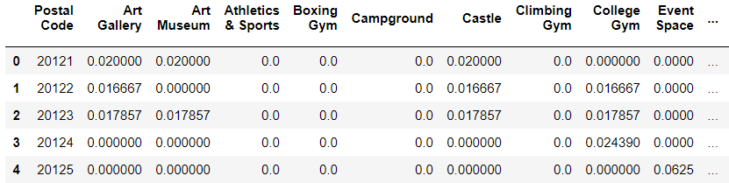
One hot encoding mean
Then I group this dataframe for postal code and compute the mean of each category frequency.

Slide 14
5 top common venues
For each postal code I compute the 5 top most common venues along with their frequency of occurring.
----20121----
venue freq
0 Park 0.38
1 Gym 0.16
2 Gym / Fitness Center 0.08
3 Plaza 0.06
4 Hotel 0.06
----20122----
venue freq
0 Park 0.45
1 Gym 0.15
2 Gym / Fitness Center 0.12
3 Plaza 0.03
4 Monument / Landmark 0.03
----20123----
venue freq
0 Park 0.43
1 Gym / Fitness Center 0.14
2 Gym 0.12
3 Plaza 0.04
4 Monument / Landmark 0.04
----20124----
venue freq
0 Park 0.34
1 Hotel 0.17
2 Plaza 0.10
3 Gym 0.10
4 Gym / Fitness Center 0.10
……

Slide 15
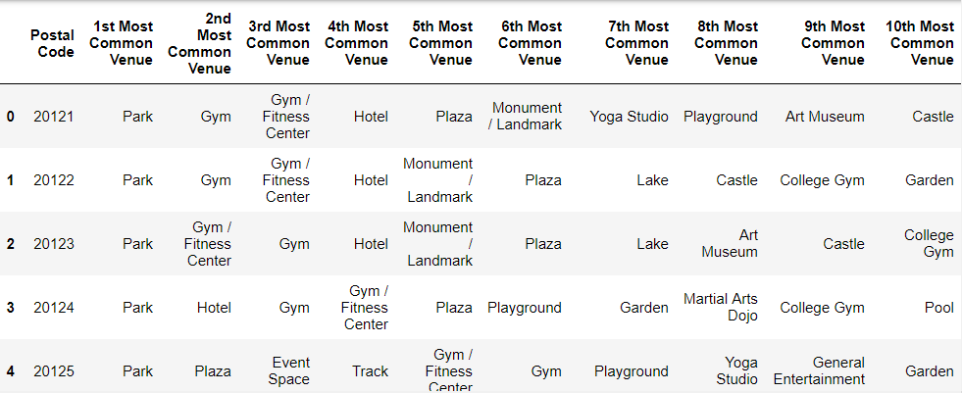
10 top common venues

Slide 16
Cluster Neighborhoods analysis
After removing the postal code column, I decided to run k-means to cluster the postal code into 5 different clusters.

Slide 17
Cluster #1
 | Postal Code | 1st Most Common Venue | 2nd Most Common Venue | 3rd Most Common Venue | 4th Most Common Venue | 5th Most Common Venue | 6th Most Common Venue | 7th Most Common Venue | 8th Most Common Venue | 9th Most Common Venue | 10th Most Common Venue
17 | 20138 | Park | Gym / Fitness Center | Pool | Yoga Studio | Hotel | Gym Pool | Gym | General Entertainment | Garden | Event Space
22 | 20143 | Park | Gym | Gym / Fitness Center | Harbor / Marina | Athletics & Sports | College Gym | Hotel | Pool | Garden | Gym Pool
23 | 20144 | Park | Gym / Fitness Center | Yoga Studio | Pool | Public Art | Plaza | Martial Arts Dojo | Boxing Gym | Campground | Castle
25 | 20146 | Park | Gym / Fitness Center | Gym | Martial Arts Dojo | Yoga Studio | Hotel | Gym Pool | General Entertainment | Garden | Event Space
26 | 20147 | Park | Gym | Pool | Martial Arts Dojo | Gym / Fitness Center | Yoga Studio | Gym Pool | General Entertainment | Garden | Event Space
32 | 20153 | Park | Campground | Gym | Yoga Studio | Garden | Harbor / Marina | Gym Pool | Gym / Fitness Center | General Entertainment | Event Space
35 | 20156 | Park | Gym Pool | Playground | Yoga Studio | Hotel | Gym / Fitness Center | Gym | General Entertainment | Garden | Event Space
36 | 20157 | Park | Gym / Fitness Center | Pool | Yoga Studio | Hotel | Gym Pool | Gym | General Entertainment | Garden | Event Space

Slide 18
Cluster #2
 | Postal Code | 1st Most Common Venue | 2nd Most Common Venue | 3rd Most Common Venue | 4th Most Common Venue | 5th Most Common Venue | 6th Most Common Venue | 7th Most Common Venue | 8th Most Common Venue | 9th Most Common Venue | 10th Most Common Venue
0 | 20121 | Park | Gym | Gym / Fitness Center | Hotel | Plaza | Monument / Landmark | Yoga Studio | Playground | Art Museum | Castle
1 | 20122 | Park | Gym | Gym / Fitness Center | Hotel | Monument / Landmark | Plaza | Lake | Castle | College Gym | Garden
2 | 20123 | Park | Gym / Fitness Center | Gym | Hotel | Monument / Landmark | Plaza | Lake | Art Museum | Castle | College Gym
3 | 20124 | Park | Hotel | Gym | Gym / Fitness Center | Plaza | Playground | Garden | Martial Arts Dojo | College Gym | Pool
6 | 20127 | Park | Gym | Plaza | Gym / Fitness Center | College Gym | Martial Arts Dojo | Event Space | Playground | Pool | Track
8 | 20129 | Park | Gym / Fitness Center | Plaza | Gym | Garden | Monument / Landmark | Yoga Studio | College Gym | Gym Pool | Playground
10 | 20131 | Park | Gym | Gym / Fitness Center | Plaza | Pool | Yoga Studio | Playground | Martial Arts Dojo | College Gym | Supermarket
11 | 20132 | Park | Gym / Fitness Center | Martial Arts Dojo | Event Space | Gym | Neighborhood | College Gym | Plaza | Garden | General Entertainment
12 | 20133 | Park | Gym / Fitness Center | Gym | Plaza | College Gym | Supermarket | Monument / Landmark | Garden | Event Space | General Entertainment
29 | 20150 | Hotel | Resort | Gym / Fitness Center | Gym | Pool | Sports Club | Park | Climbing Gym | Event Space | Campground
40 | 20161 | Park | Gym / Fitness Center | Hotel | Gym | Pool | Yoga Studio | Gym Pool | General Entertainment | Garden | Event Space

Slide 19
Cluster 3
 | Postal Code | 1st Most Common Venue | 2nd Most Common Venue | 3rd Most Common Venue | 4th Most Common Venue | 5th Most Common Venue | 6th Most Common Venue | 7th Most Common Venue | 8th Most Common Venue | 9th Most Common Venue | 10th Most Common Venue
9 | 20130 | Gym | Yoga Studio | Event Space | Harbor / Marina | Gym Pool | Gym / Fitness Center | General Entertainment | Garden | College Gym | Italian Restaurant

Slide 20
Cluster 4
 | Postal Code | 1st Most Common Venue | 2nd Most Common Venue | 3rd Most Common Venue | 4th Most Common Venue | 5th Most Common Venue | 6th Most Common Venue | 7th Most Common Venue | 8th Most Common Venue | 9th Most Common Venue | 10th Most Common Venue
19 | 20140 | Gym / Fitness Center | Park | Yoga Studio | Italian Restaurant | Harbor / Marina | Gym Pool | Gym | General Entertainment | Garden | Event Space
21 | 20142 | Gym / Fitness Center | Park | Yoga Studio | Italian Restaurant | Harbor / Marina | Gym Pool | Gym | General Entertainment | Garden | Event Space

Slide 21
Cluster 5
 | Postal Code | 1st Most Common Venue | 2nd Most Common Venue | 3rd Most Common Venue | 4th Most Common Venue | 5th Most Common Venue | 6th Most Common Venue | 7th Most Common Venue | 8th Most Common Venue | 9th Most Common Venue | 10th Most Common Venue
4 | 20125 | Park | Plaza | Event Space | Track | Gym / Fitness Center | Gym | Playground | Yoga Studio | General Entertainment | Garden
5 | 20126 | Park | Pool | Gym | Event Space | Martial Arts Dojo | Climbing Gym | Playground | Gym / Fitness Center | General Entertainment | Garden
7 | 20128 | Park | Pool | Gym | Event Space | Martial Arts Dojo | Climbing Gym | Gym Pool | Gym / Fitness Center | General Entertainment | Garden
13 | 20134 | Park | Gym | Garden | Gym / Fitness Center | Neighborhood | Plaza | Yoga Studio | Gym Pool | General Entertainment | Event Space
14 | 20135 | Park | Gym | Pool | Yoga Studio | Boxing Gym | Garden | Martial Arts Dojo | Monument / Landmark | Art Gallery | Sports Club
15 | 20136 | Park | Gym | Gym / Fitness Center | Pool | Yoga Studio | Gym Pool | Vegetarian / Vegan Restaurant | Martial Arts Dojo | Monument / Landmark | Plaza
18 | 20139 | Park | Gym / Fitness Center | Gym | Gym Pool | Pool | Yoga Studio | Hotel | General Entertainment | Garden | Event Space
20 | 20141 | Park | Hotel | Gym / Fitness Center | Gym | Pool | Martial Arts Dojo | Yoga Studio | Gym Pool | General Entertainment | Garden
24 | 20145 | Park | Gym / Fitness Center | Gym | Yoga Studio | Art Museum | Martial Arts Dojo | Gym Pool | Garden | General Entertainment | Event Space
27 | 20148 | Park | Pool | Gym Pool | Gym | Gym / Fitness Center | Playground | Hotel | Yoga Studio | General Entertainment | Garden
28 | 20149 | Park | Gym | Pool | Gym / Fitness Center | Gym Pool | Yoga Studio | Hotel | Monument / Landmark | Playground | Lake
30 | 20151 | Park | Pool | Gym | Gym / Fitness Center | Playground | Yoga Studio | Gym Pool | General Entertainment | Garden | Event Space
31 | 20152 | Park | Pool | Gym | College Gym | Yoga Studio | Gym Pool | Gym / Fitness Center | General Entertainment | Garden | Event Space
33 | 20154 | Park | Gym | Gym / Fitness Center | Lake | Art Museum | Italian Restaurant | Castle | Road | Monument / Landmark | Plaza
34 | 20155 | Park | Gym | Gym / Fitness Center | Monument / Landmark | Playground | College Gym | Yoga Studio | Garden | Gym Pool | General Entertainment
37 | 20158 | Park | Gym Pool | Gym / Fitness Center | Gym | College Gym | Yoga Studio | Garden | Harbor / Marina | General Entertainment | Event Space
38 | 20159 | Park | Gym | Pool | Gym / Fitness Center | Yoga Studio | Gym Pool | Playground | Hotel | General Entertainment | Garden
39 | 20160 | Pool | Park | College Gym | Yoga Studio | Gym Pool | Gym / Fitness Center | Gym | General Entertainment | Garden | Event Space
41 | 20162 | Park | Pool | Gym | Gym / Fitness Center | Playground | Yoga Studio | Gym Pool | General Entertainment | Garden | Event Space

Slide 22
Discussion
In order of importance, the venues I am mostly interested in are:
swimming pool
gym
Park
so I would like to find a postal code where this order is more or less respected.
I will not consider cluster 1 because the first most common venues are parks which are the one I am less interested in. Then at the second position there are gyms and swimming pools are only at the third position.
For cluster 2: parks are the most common venues, in the second position there are
For cluster 3 we have only postal code 20130, but swimming pool are only at 5th position in term of importance. the gyms and pools appear only at 5th position.
In cluster 4 there are only 2 postal codes 20140 and 20142 where swimming pools are only in six position.

Slide 23
Discussion
Cluster 5 is the biggest one and this is the cluster I want to concentrate on. This cluster contains the postal code of my office which is 20151. I can see how for this postal code the first most common venues are Park but Pools are the second most common venues. Moreover swimming pools appears even in the 7th position. For postal code 20152 which is close to my office as well, swimming pools appear in the second position and in the 6th one. I can also see how in this cluster swimming pools appear in different postal codes. For example for 20128, 20151 and 20162 pools appear in the second and in the 7th position. For 20136 pools appear in 4th and 6th position. For 20139 pools appear in the 4th and 5th position. For 20141 pools appear in the 5th and 8th position. For 20148 pools apper in the second and third position. For 20149pools appear in third and 5th position. For 20159 pools appear in the third and 6th position. But there is only one postal code in which pools appear in the first position and in the 5th one: the 20160.

Slide 24
Conclusion
In postal code 20160 Park are in the second position and there are also many gyms at third, 4th, 6th and 7th positions. In this area there also gardens and place where event can take place. I think this is the postal code where I want to live. Now I can go more in details in the different streets and search for some apartments or rooms to rent.

